Slide 1

Indian Institute of Information Technology , Surat MINI PROJECT PRESENTATION
Presenters: Devika Verma (UI22EC19)
Aman Parmar (UI22EC07)
Supervised by:
Dr. Sudeep Sharma
Assistant Professor, IIIT Surat

Slide 2
Problem Statement
Autonomous Online Assessments Malpractice Detection "Leveraging AI and Machine Learning for Secure Online Assessments"
Ensuring the integrity of online assessments is a growing challenge due to sophisticated malpractice methods.

Slide 3





Challenges in Online Assessments
Rapid Growth of Online Education
Increased demand for flexible learning.
Validity and Reliability
Consistency and fairness
Online Exams Critical
Identity theft & cheating prevalent.

Slide 4







Objectives and Benefits
AI Malpractice
Detection
Identity Verification
Privacy and Security
Real-time fraud detection using AI.
Accurate identity verification with biometrics.
Secure data privacy and protection.
Scalability
User Experience and Accessibility
Scalable system for growing demands.
seamless and accessible user experience for all candidates.

Slide 5
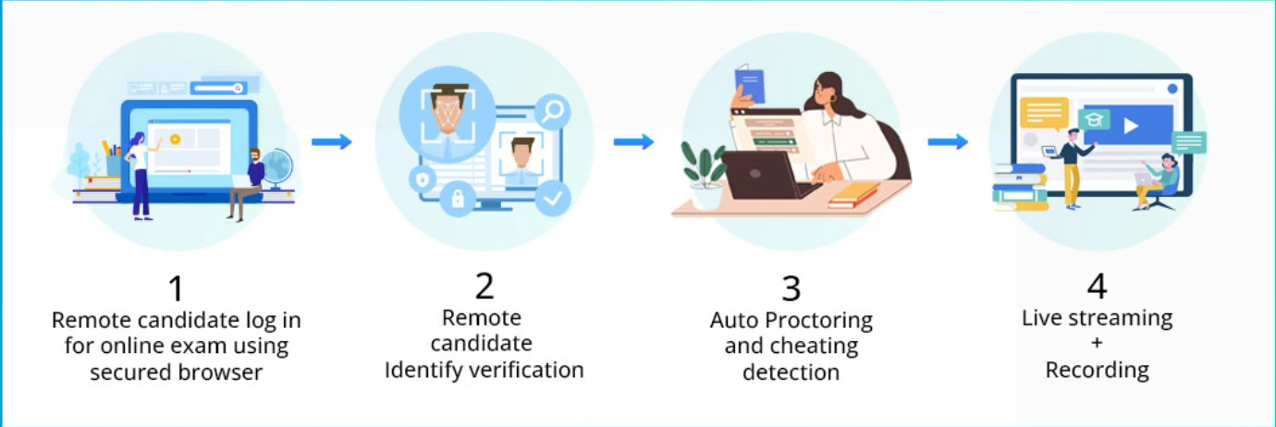
System Overview
Step-by-Step Workflow of the System
1
2
3
4
5
Candidate Login
Biometric
Real-Time Monitoring
Malpractice
Detection
Post-Exam Analysis
Authentication

Slide 6





Technology Stack
Frontend
Backend
ML Algorithm
Security
Description of frontend technologies
Description of backend technologies
Description of ML algorithms
Description of security measures
Api
Google Cloud Video Intelligence API

Slide 7
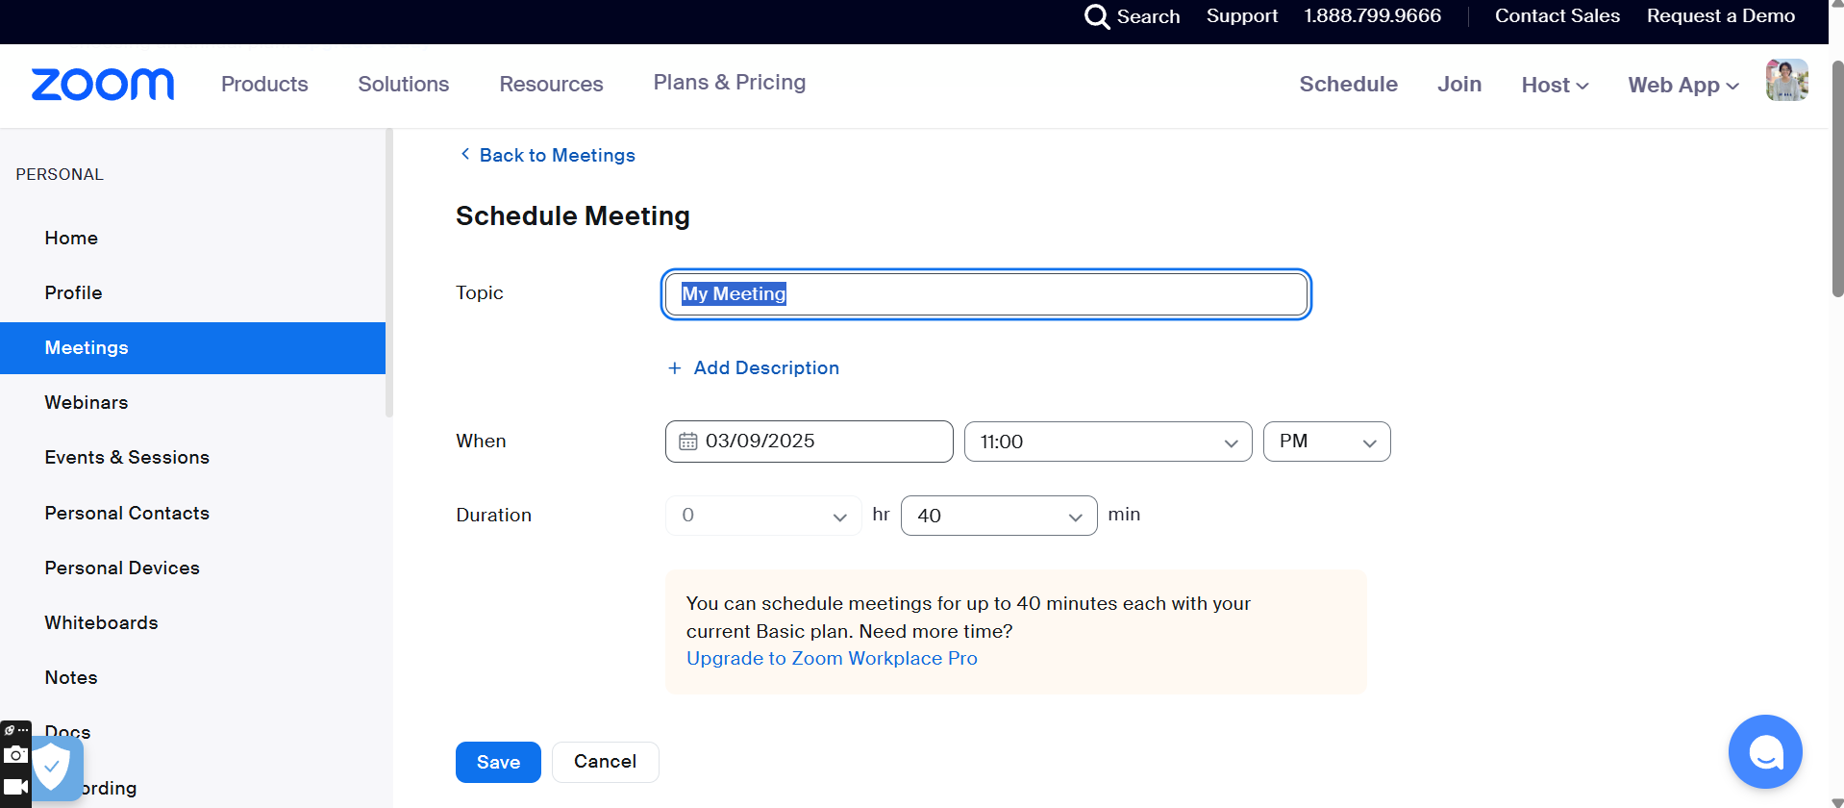


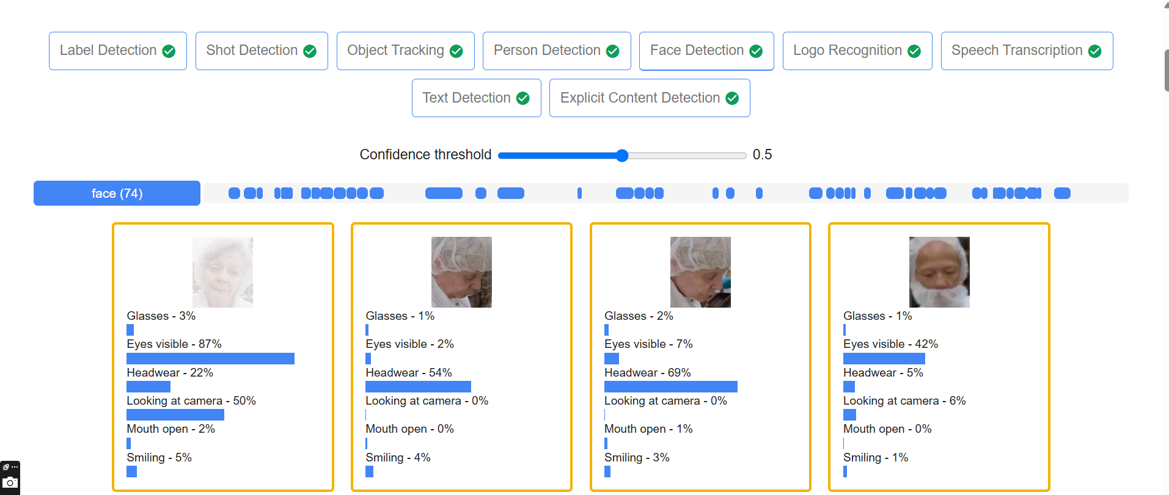
API Integration
1. Zoom Meeting Recording
https://us05web.zoom.us/meeting/schedule
2.Cloud Video Intelligence API
Cloud Video Intelligence API Documentation: Comprehensive analysis for object, person, and content detection in video feeds.

Slide 8
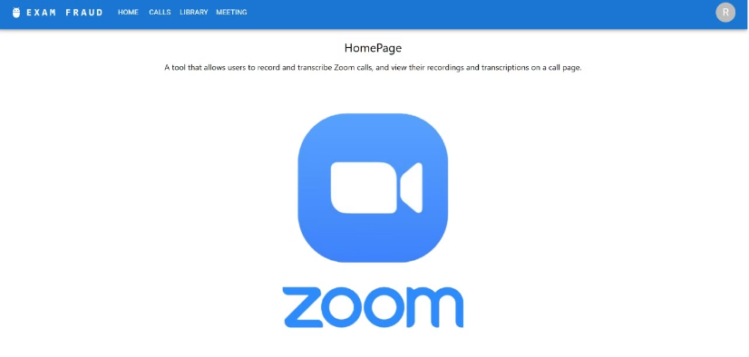
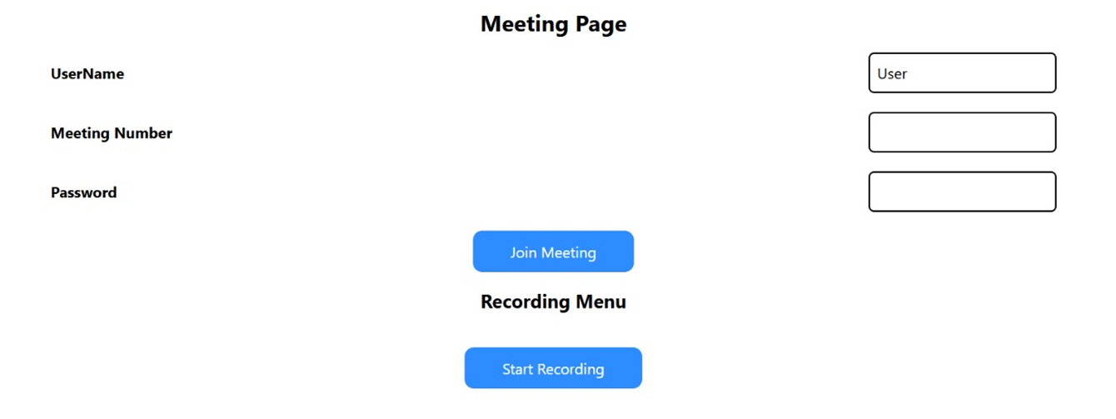
Current Progress
Front End Deployment:-
The front end is designed with a user-friendly interface to ensure ease of navigation and a seamless experience for both students and administrators.

Slide 9

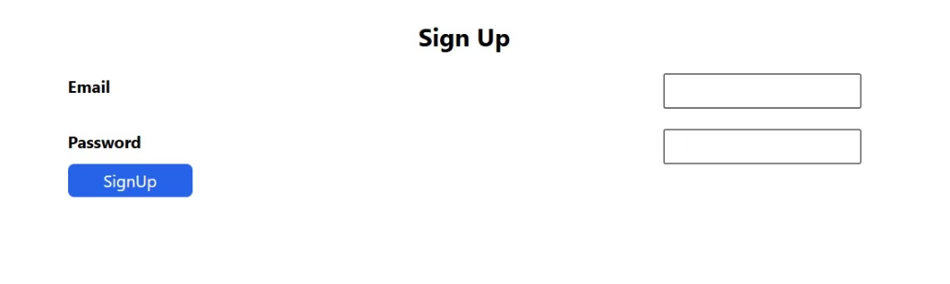
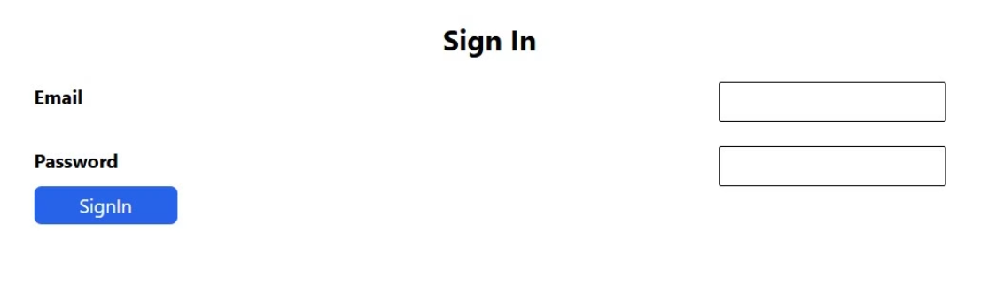
Current Progress
Secure login and Sign up :-
The user can seculy login or sign up to our application through firebase and the data base is stored in fire base fire store
Sign-up: User data is securely stored using Firebase integration.
Sign-in: Firebase integration ensures secure authentication for users.

Slide 10
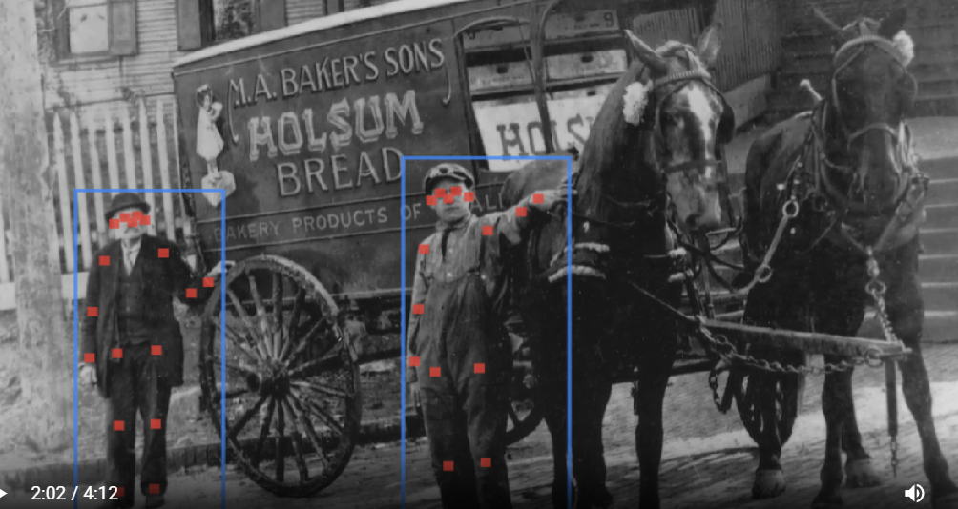



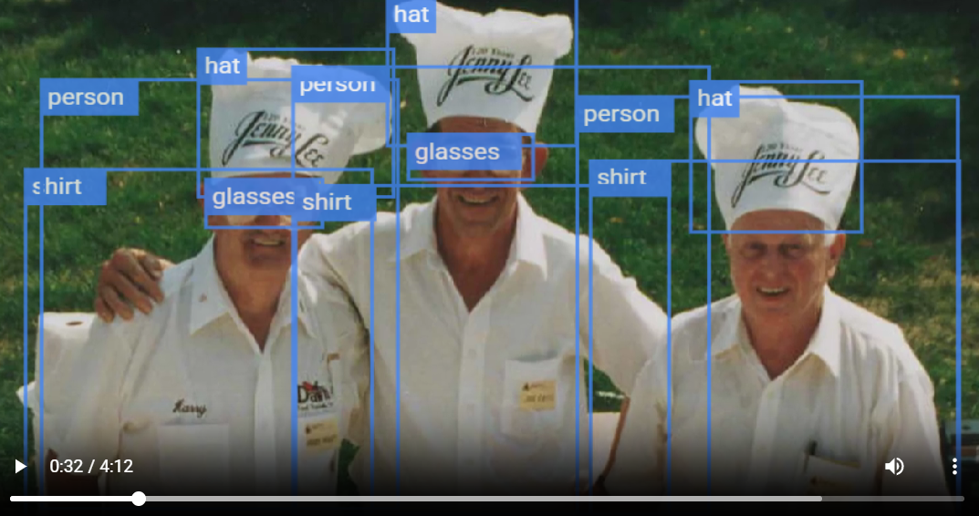
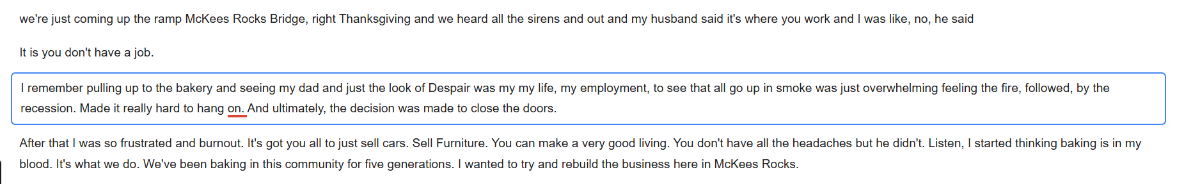
Future Integrations
1: Registering Biometric Information
using CNNs
3: Person Detection
2: Object Tracking
4: Speech Recognition and Transcript
5: Explicit Content Detection

Slide 11
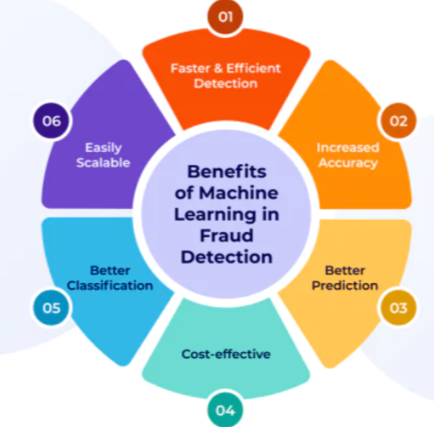
Future scope
Privacy Concerns:
Smarter AI:
Continuous monitoring raises ethical questions.
Use advanced machine learning for even better real-time detection.
Data storage and usage policies need to be very clear.
Risk of data breaches.
Analyze typing patterns, mouse movements , eye tracking .

Slide 12
References
1
Cloud Video Intelligence API Documentation
2
ResearchGate Publication
3
SciTePress Paper
A.C.M. Nafrees, S.A. Asra, and R.K.A.R. Kariapper, ”Machine Learning for Au tonomous Online Exam Fraud Detection: A Concept Design,” October 2023. Available at: https://www.researchgate.net/publication/374420758_Mac hine_learning_for_autonomous_online_exam_fraud_detection_A_concept _design.
M. A. Haytom, C. Rosenberger, C. Charrier, C. Zhu, and C. Regnier, ”Identity Verification and Fraud Detection During Online Exams with a Privacy Compliant Biometric System,” 2020. Available at: https://www.scitepress.org/Papers/ 2020/98741/98741.pdf.
Details features used for video analysis in our system.

Slide 13

Conclusion
In conclusion, our Autonomous Online Assessment malpractice Detection System leverages cutting-edge AI and biometric technologies to ensure secure, fair, and scalable online assessments. By focusing on real-time fraud detection, identity verification, privacy, cheating prevention, scalability, and user experience, we aim to revolutionize online exams, making them more trustworthy and accessible for all. This system not only addresses current challenges but also paves the way for a future where online education is both secure and inclusive.

Slide 14

Q&A

